Slide 1
Empowering Career Choices with AI Chatbot: Future Pathways
This presentation introduces an AI chatbot for career guidance in computer science.
It addresses Sustainable Development Goal No. 8 - Decent Work and Economic Growth,
using IBM Cloud and Watson Assistant.

Slide 2
Sustainable Development Goal (SDG) No. 8
Decent Work and Economic Growth
1
Promoting Employment Opportunities
2
Enhancing Skill Development
Ensuring access to decent work opportunities and economic growth is essential for sustainable development..
Providing resources and guidance to enhance skills in the computer science field.
3
Reducing Unemployment
4
Supporting Lifelong Learning
Addressing unemployment through career guidance and job matching services.
Encouraging continuous learning and development to adapt to the evolving job market.

Slide 3


Utilizing IBM Cloud and Watson Assistant
IBM Cloud
Provides a secure and scalable infrastructure for developing and deploying the AI chatbot.
Watson Assistant
A powerful AI platform that enables the creation of natural language conversational interfaces.

Slide 4




Solving the Healthcare Problem with AI
Career Assessments
The AI can conduct a comprehensive career assessment to evaluate individual interests, skills, and values, providing personalized career recommendations based on the results.
Skill Development Courses
The AI can suggest targeted skill development courses based on the user's career goals and current skill set.
Job Market Insights
The AI can provide real-time job market insights, including in-demand skills, industry trends, and salary benchmarks, tailored to the user's career interests.
Interview Preparation
The chatbot offers tips and resources for effective interview preparation and career advancement.

Slide 5

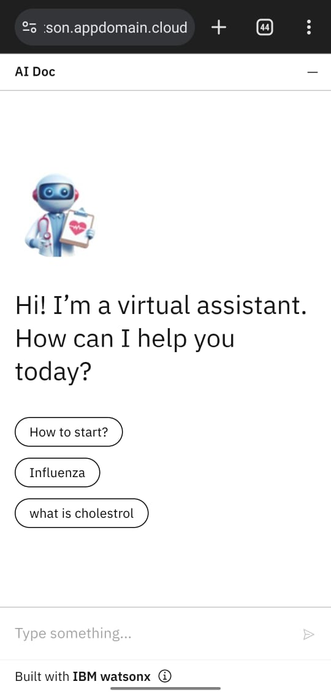
Link to model
To access the AI chatbot model and see its interface, please visit :
https://cloud-object-storage-cos-static-web-hosting-83e.s3.jp-tok.cloud-object-storage.appdomain.cloud/Project/index.html

Slide 6
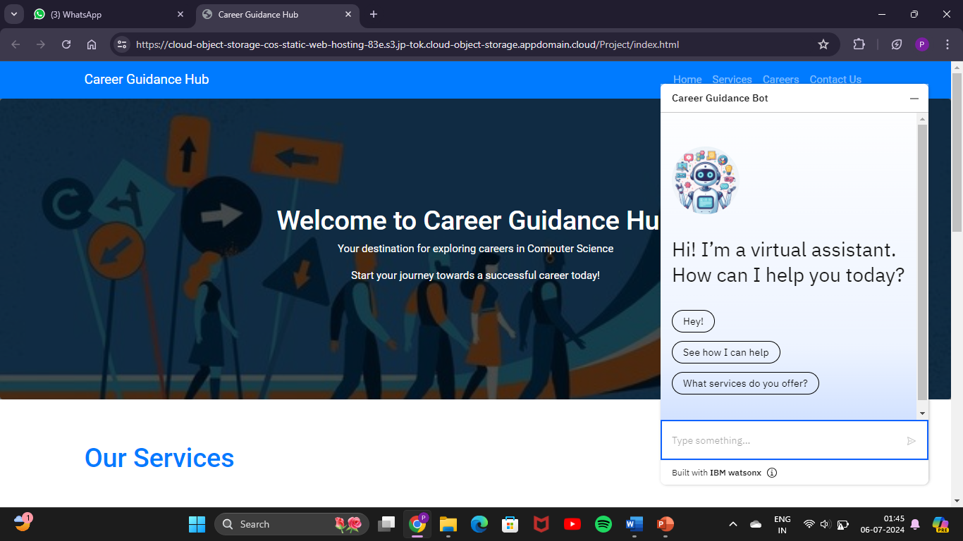
Chatbot Screenshots
Screenshot of website.
Screenshot No.1

Slide 7
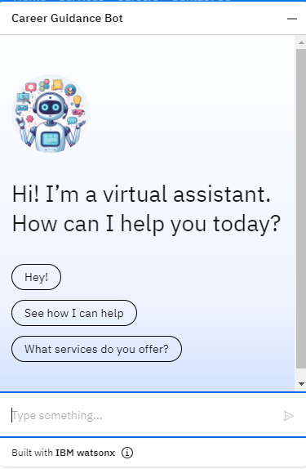
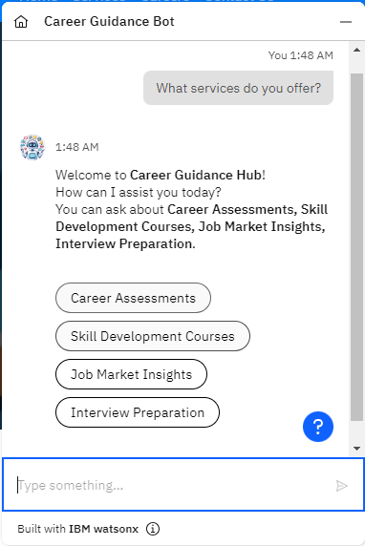
Screenshot No. 2
Screenshot No. 3

Slide 8
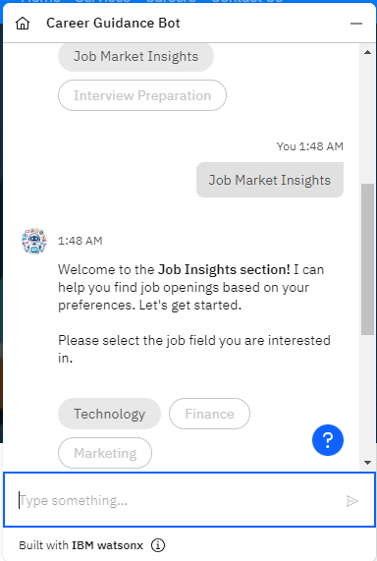
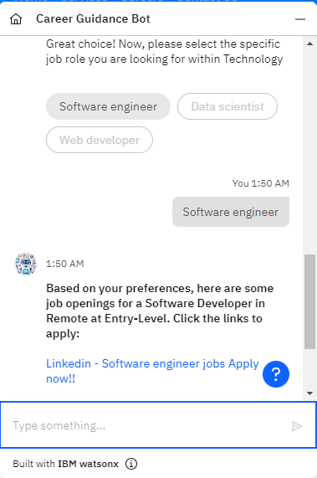
Screenshot No. 4
Screenshot No. 5

Slide 9
Team members :-
NAME | EMAIL ID
Purva Deepak Agine | r210274@famt.ac.in
Harsh Umesh Bhingarde | r210243@famt.ac.in
Sumit Ratnakar Rajam | r210294@famt.ac.in
Kaiwalya Indranil Surve | r210261@famt.ac.in
Umar Saheel Kazi | r210122@famt.ac.in

Slide 10
Thank You
By- Team FAMT AI Architects
Finolex Academy of Management and Technology, Ratnagiri

